Slide 1




Savalalo Market Project
Project Progress Meeting 8th June 2023

Slide 2
Project Timeline
Design Competition
Conceptual Design by Sucon
Tender Documentation
Preliminary Design
Tender Period and Evaluation
4th Sept
Design Build Commences
Contract Completion
Employers Requirements
Sept 2022
12th June
Tenders Close
10th Nov
Contract Signing
16th May 2025
Practical Completion
Evaluation
Contract Negotiation
Construction Commences
Cabinet Approval

Slide 3
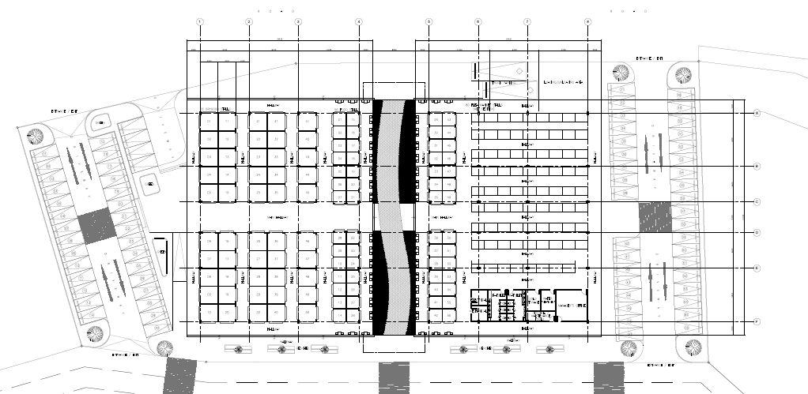
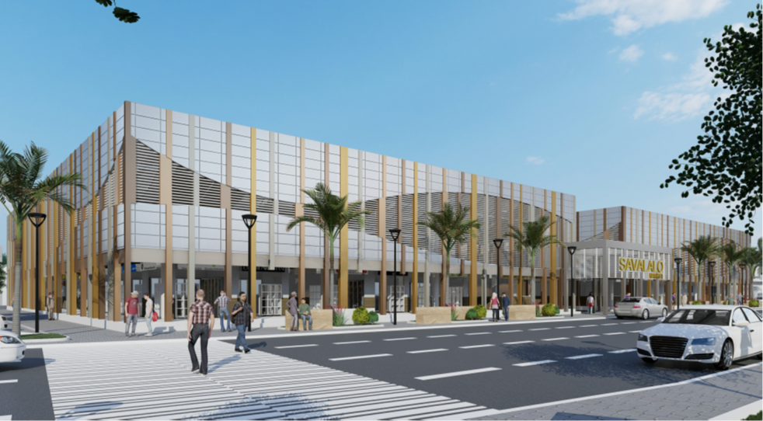
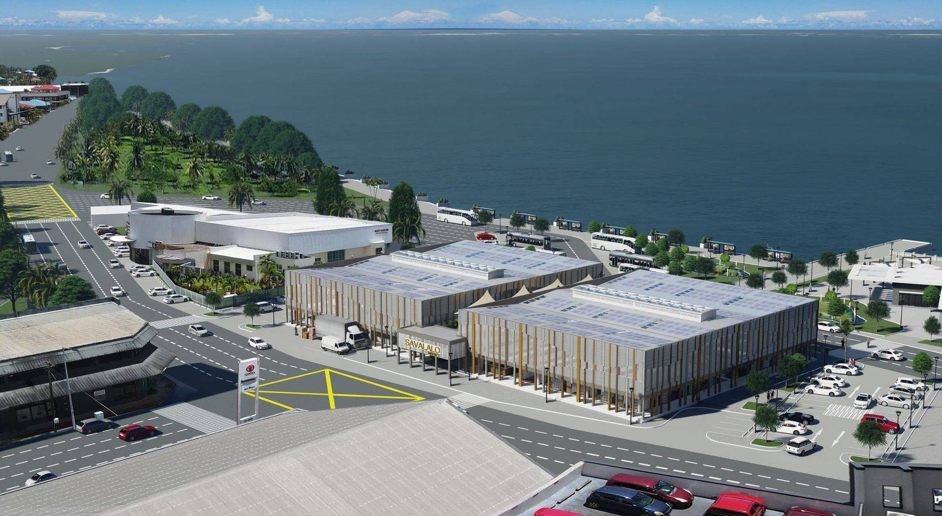
Sucon Competition Concept

Slide 4
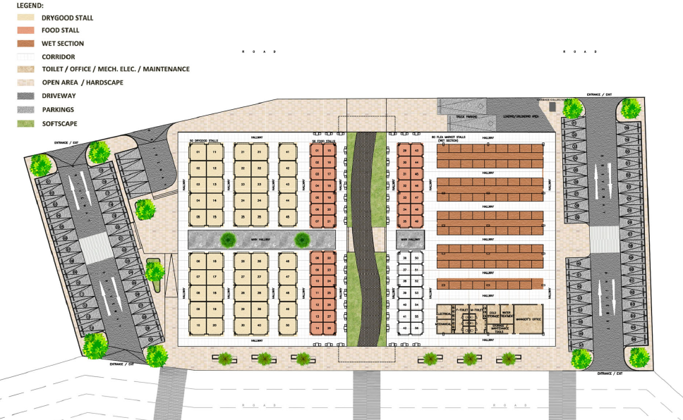
Competition Concept Plan

Slide 5

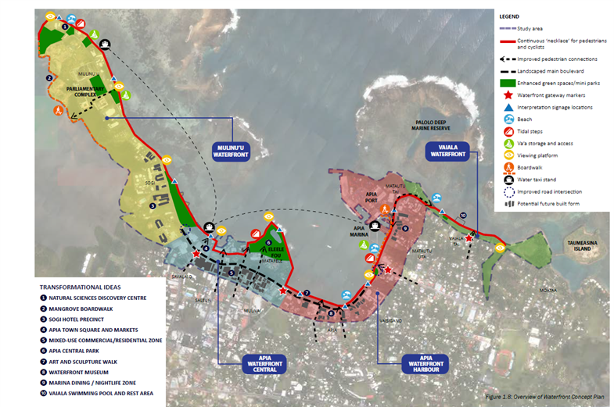


Employers Requirements

Slide 6
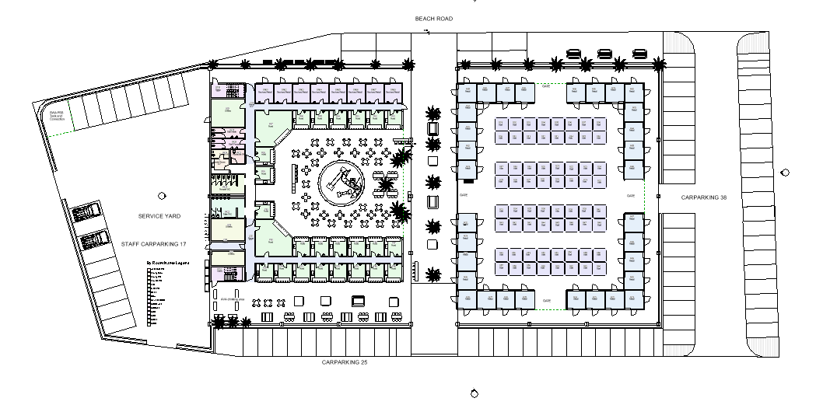
TGA/SLC Preliminary Plan – Ground Floor

Slide 7
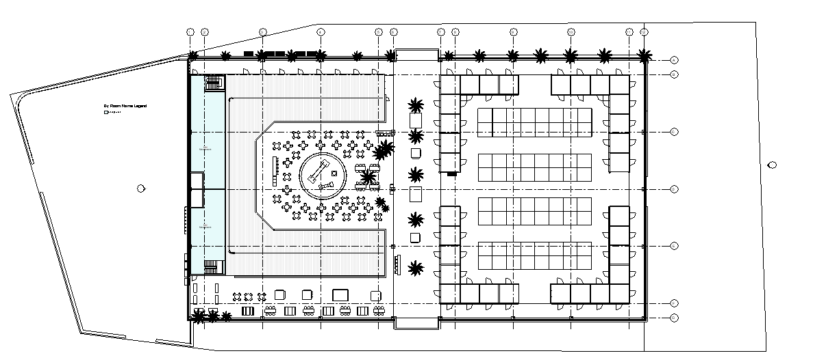
TGA/SLC Preliminary Plan – Mezzanine

Slide 8
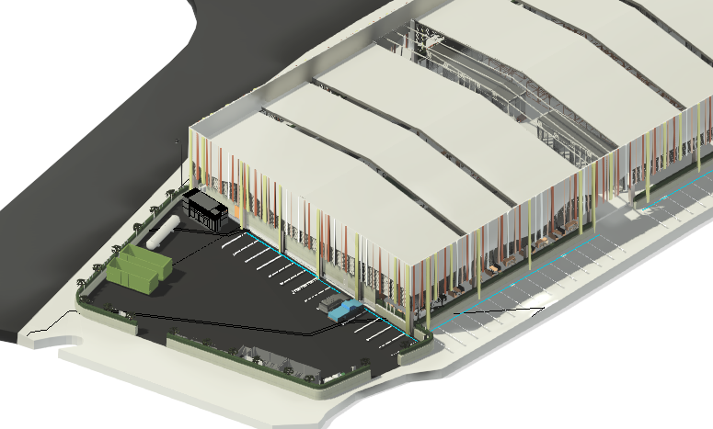
Preliminary Design - Services Yard

Slide 9
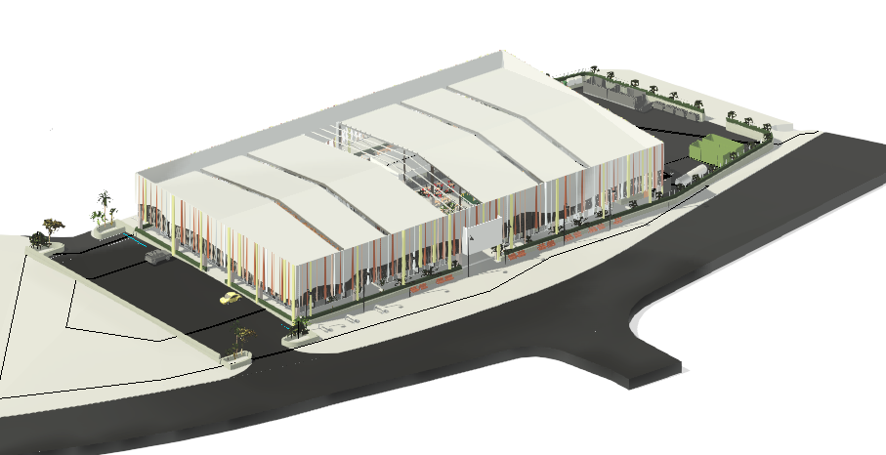
Preliminary Design - South Entry

Slide 10
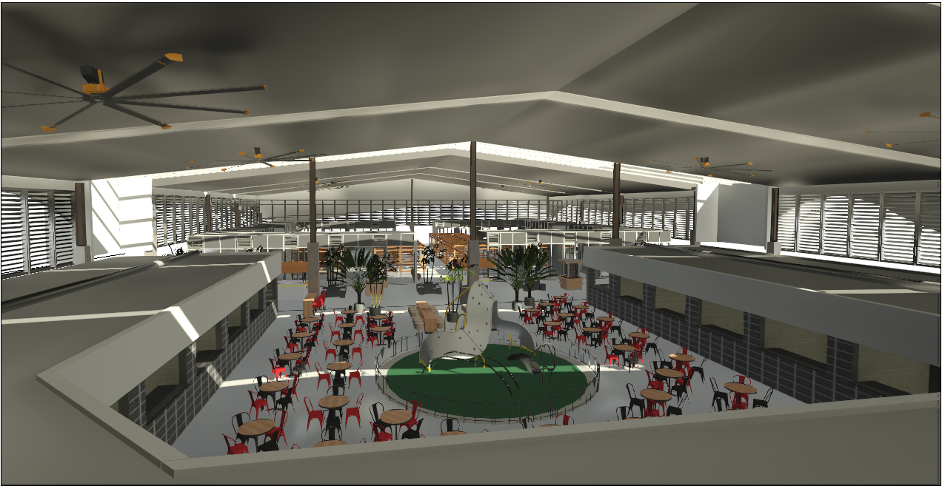
Food Stalls

Slide 11
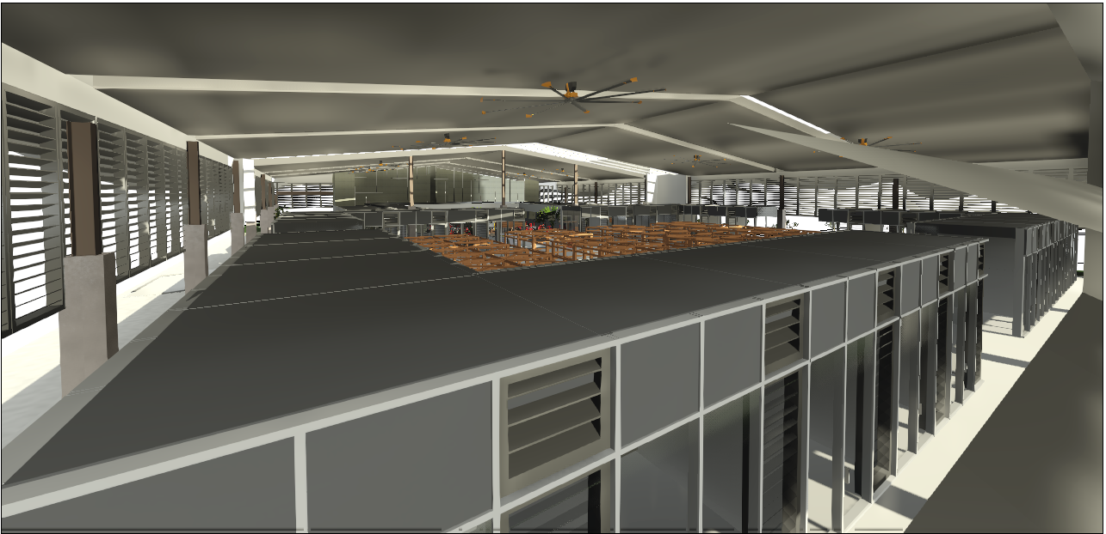
Retail Stalls

Slide 12
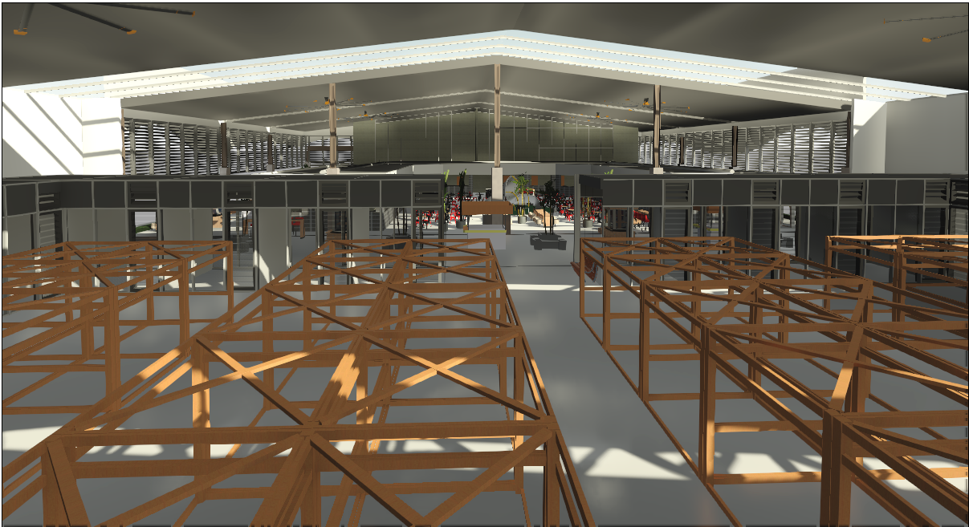
Flea Market Stalls

Slide 13
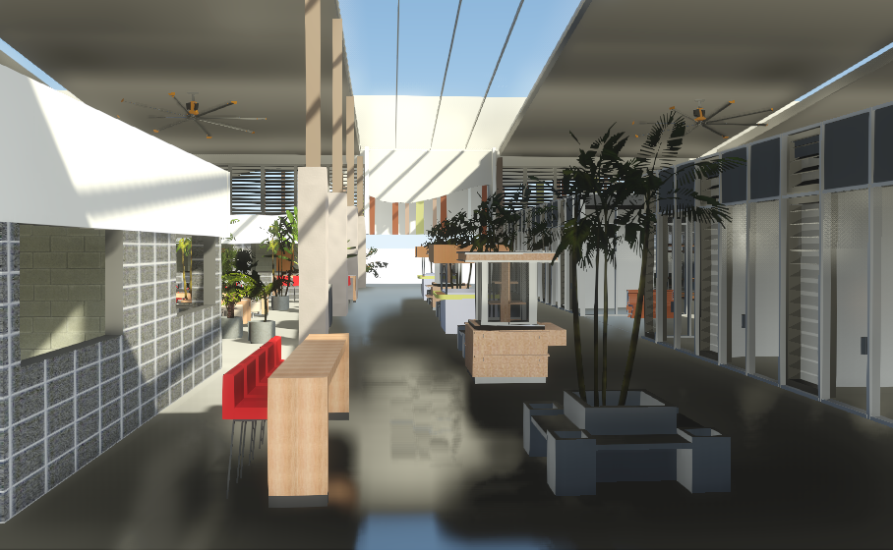
Internal Street

Slide 14
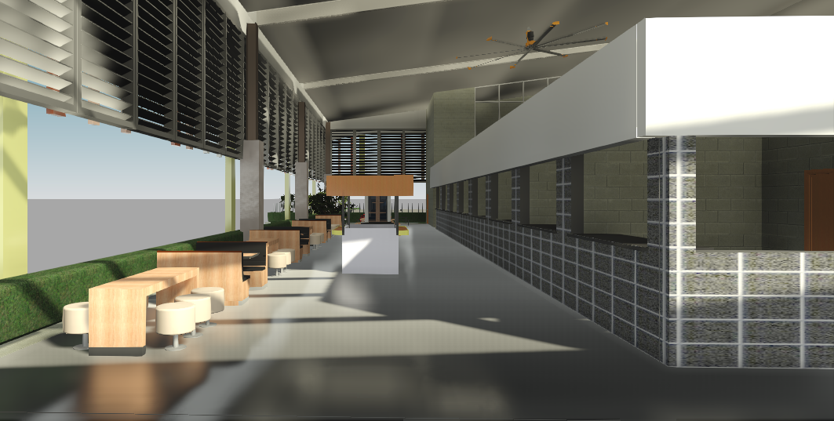
Northern Foodcourt

Slide 15
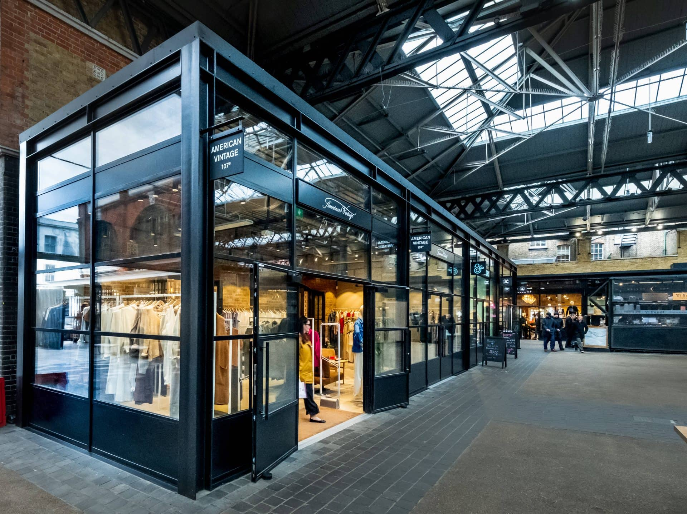

Retail Stores
Spitalfields Market

Slide 16
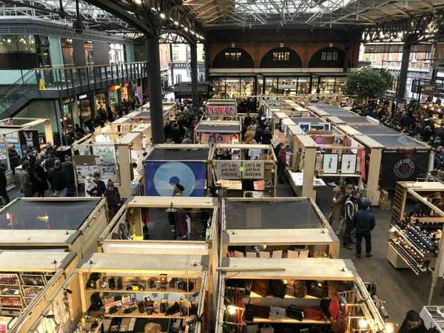

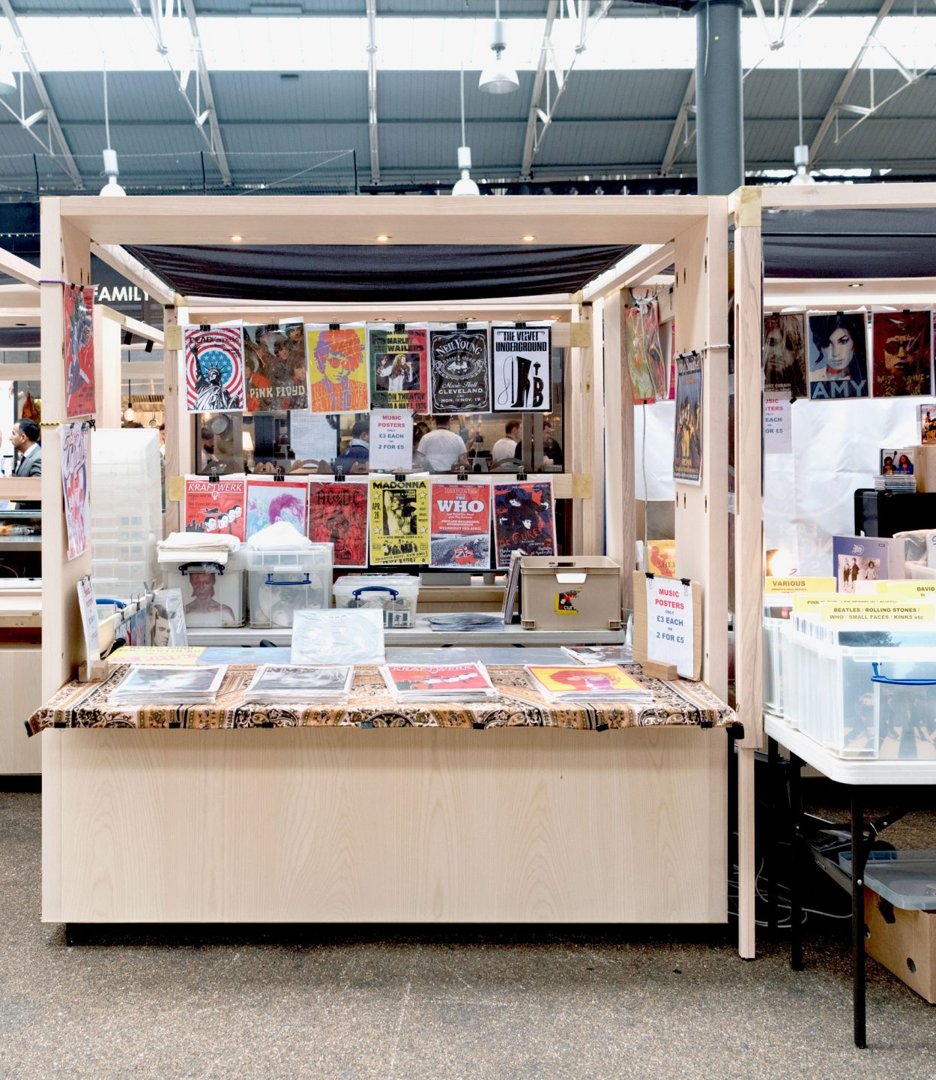
Flea Market Stalls

Slide 17

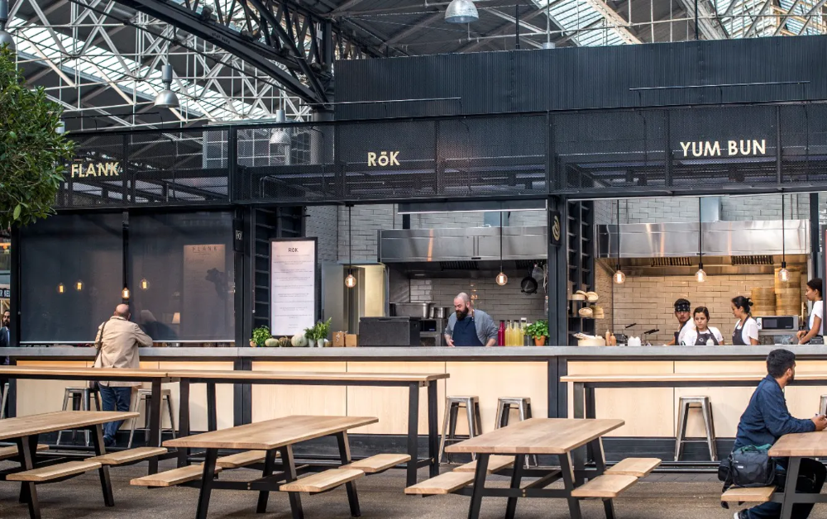
Food Stalls

